Slide 1
Solving the Drug Equation with Math
Presented by Team leader and Senior data scientist:
Jason Wu
1

Slide 2
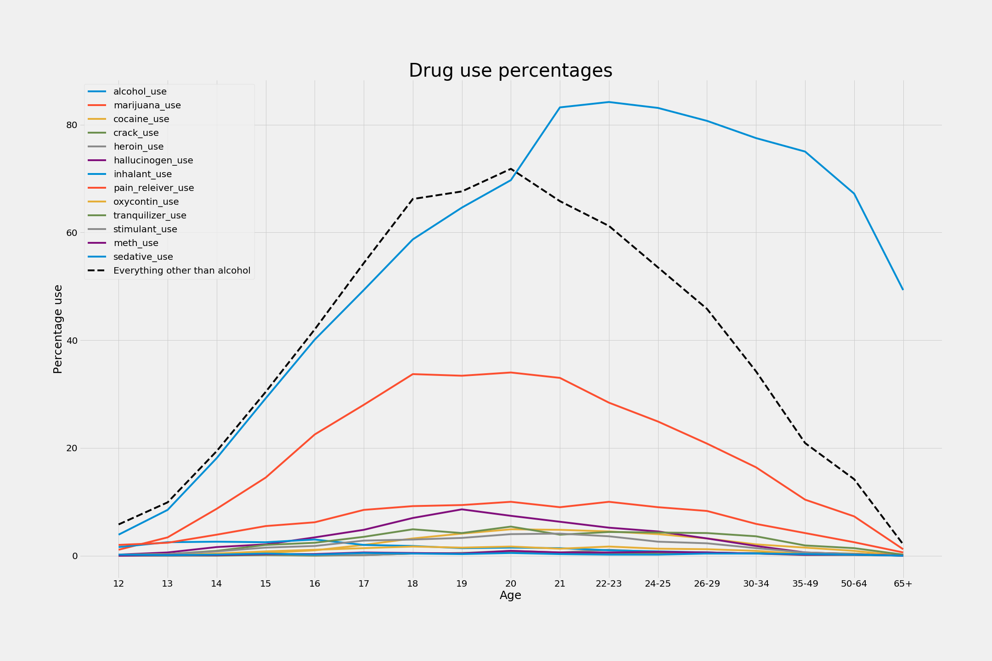
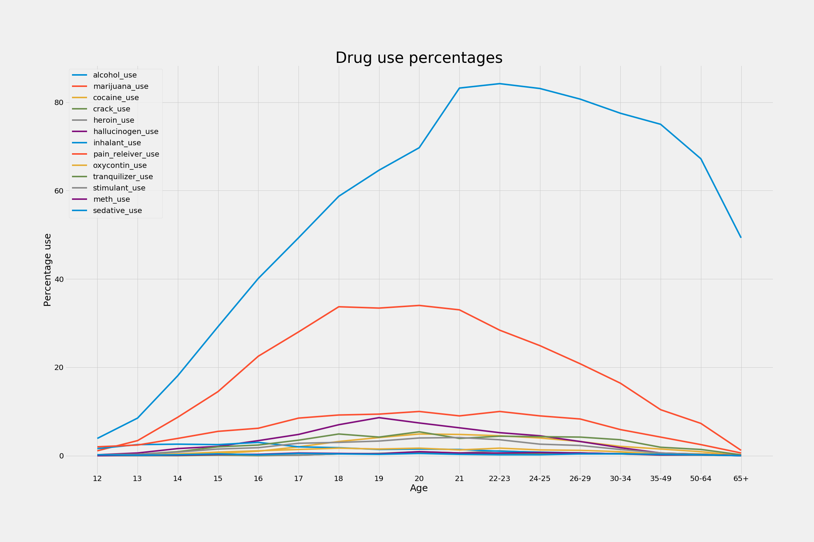
Landscape of drug use in our communities
- Most commonly used drug of choice is alcohol
-Usage of drugs increases until the age of ~21
-Alcohol percentage is almost more than all other drugs combined
2

Slide 3
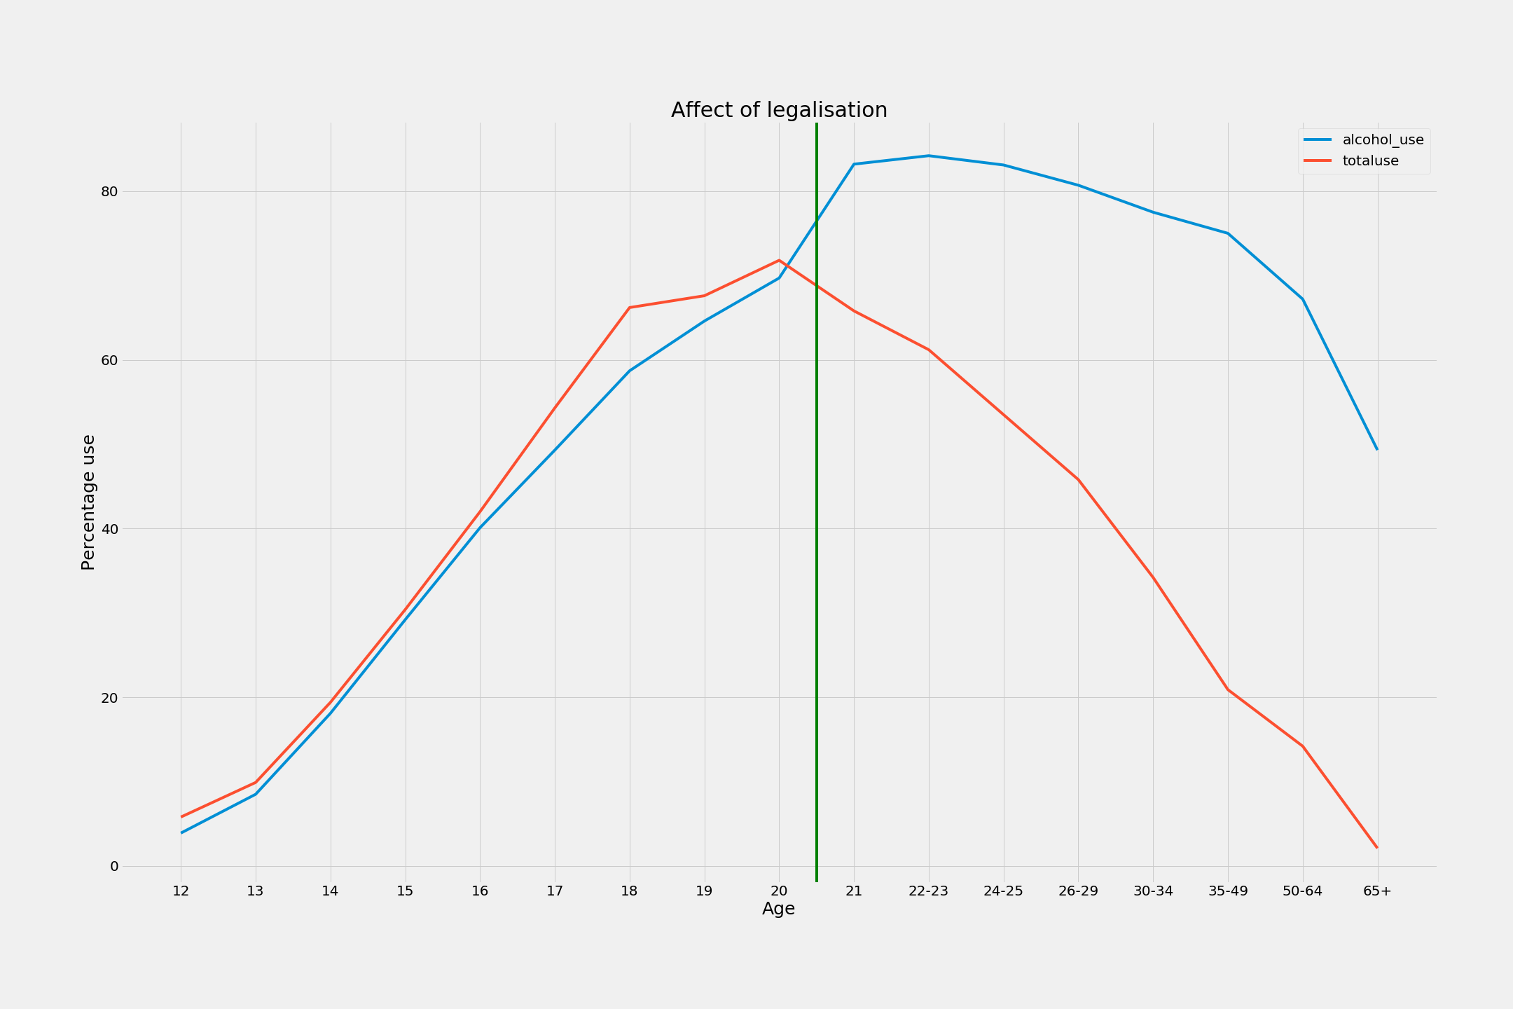
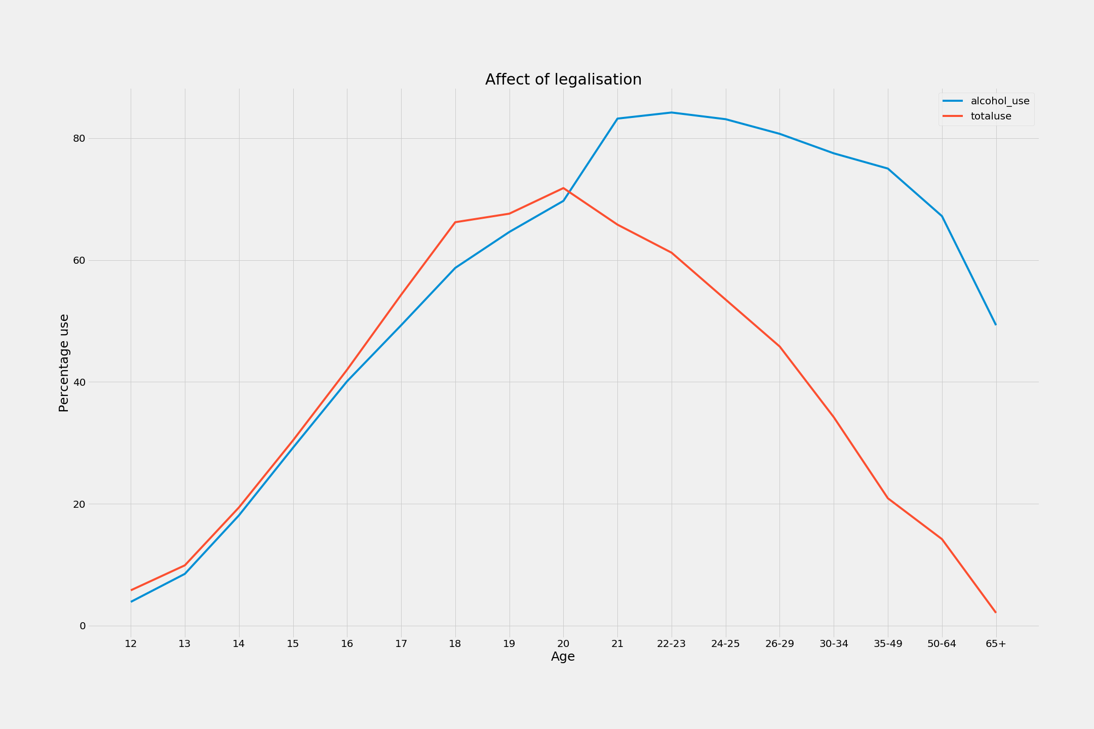
What does it all mean?
-The alcohol problem seems quite dire at first, but when compared to drug usage of all the other substances combined, the issue is much more complex.
-Same amount of people consuming alcohol illegally as other drugs.
-Legalization appears to have an effect on usage
3

Slide 4
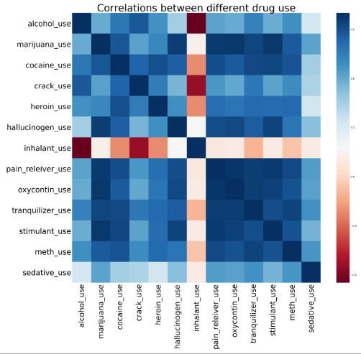
How the pieces fit together
-Almost all the drugs are positively correlated to each other
-Inhalant use is the odd one out
-Is it to do with how easily obtainable inhalants such as paint, markers and petrol are for younger people?
4

Slide 5
Is this enough information to shape our policy?
Time for some QUICK MATH:
How variable is drug use between different drugs?
H0=The variance IS the same between all drugs
H1=The variance IS NOT the same between all drugs
What if we compare alcohol use to all other drugs?
H0=The average IS the same for alcohol use and all other drugs combined
H1=The average IS NOT the same for alcohol use and all other drugs combined
Kruskal test : p<0.01
Mann-Whitney U test : p>0.01
There IS a STATISTICALLY SIGNIFICANT difference in how the different drug usages change between age groups
There ISN’T a STATISTICALLY SIGNIFICANT difference in the average use of alcohol compared to all other drugs added up
5

Slide 6
How to convert these stats to $$$
-Alcohol is the only drug in the list which has been legalised and accounts for half of all drug usage where it is ILLEGAL (under 21)
-Holistically, it doesn’t appear we can stop overall drug consumption but LEGALISATION appears to be a good tool to guide safe drug usage
-Drugs such as marijuana and hallucinogens which are not physically addictive compared to drugs such as heroin and opioids are great candidates for LEGALISATION
-The tax revenue from alcohol for 2017 for America was US$10 billion
6

Slide 7
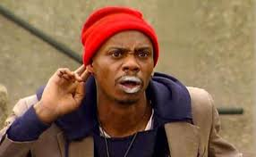
Where to from here?
Any questions?
-Legalisation of less harmful drugs such as marijuana and hallucinogens should be the way of the future
-More work needs to be done to explore why inhalant use is the only negatively correlated relationship for all other drugs. How does ease of access affect drug use?
7

